Slide 1
TDT4258: Low-Level Programming
- Introduction to ARM Assembly Language
Rakesh Kumar
Computer Architecture Lab
Department of Computer Science
Some of the slides are based on other courses around the world: ETHZ, University of Edinburgh, NTNU, etc.

Slide 2
What is an Embedded System?
Text book definition
Any device that includes a programable computer but is not itself a
general purpose computer.
An alternate definition
A computing system, specialized for only few applications with
none (or minimum) end user programmability, embedded into a
larger product.
- The main purpose of the product is not computing.

Slide 3
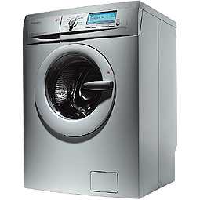
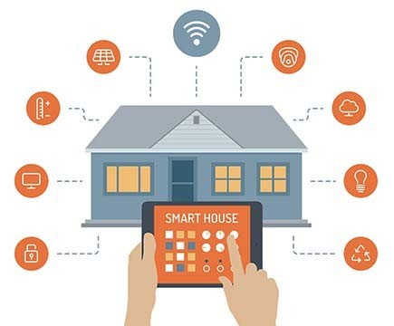



Embedded System examples
You don’t buy any of these for computing!

Slide 4
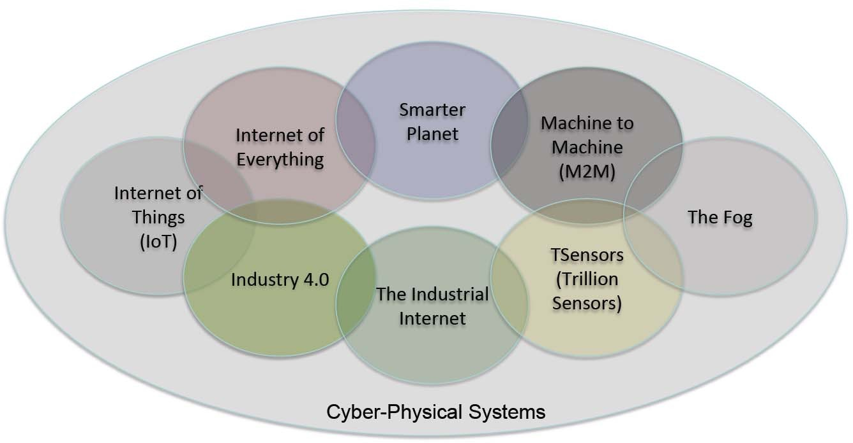
What’s in the name!
© Edward Lee

Slide 5




Embedded System market
Units shipped per year (millions)
100,000
10,000
1,000
100
10
1
Servers
Personal Computers
Mobile Devices
Embedded

Slide 6
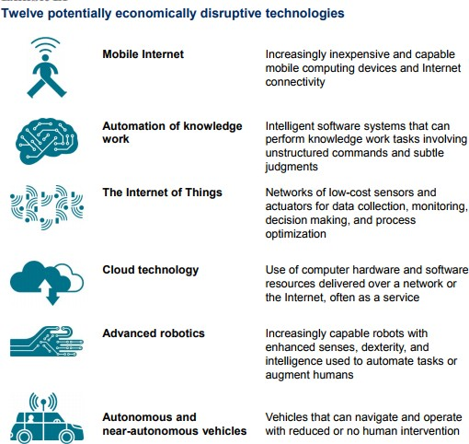
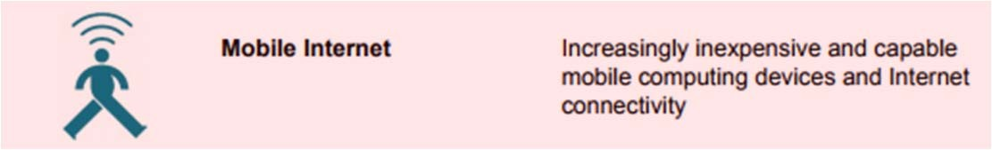
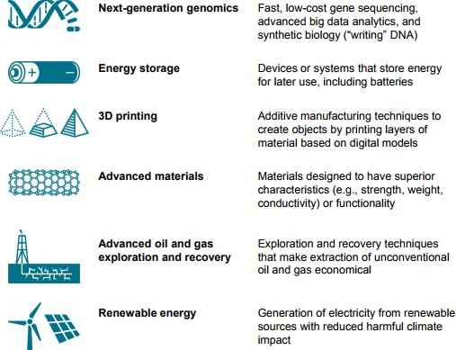
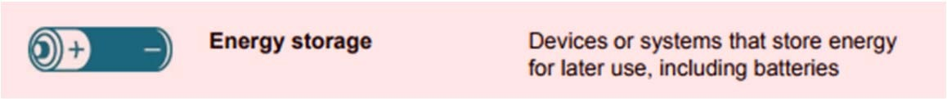
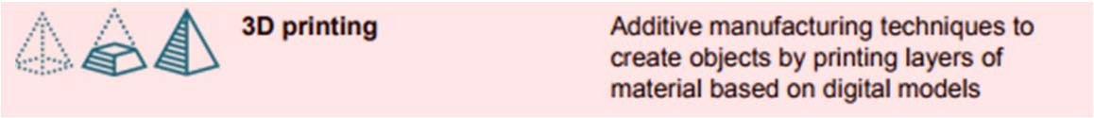
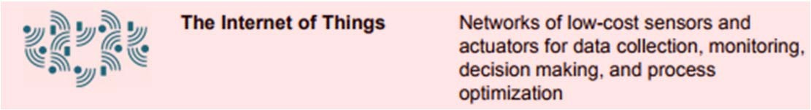
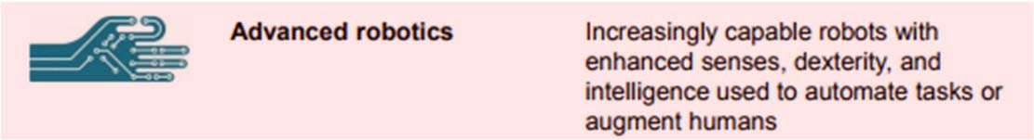

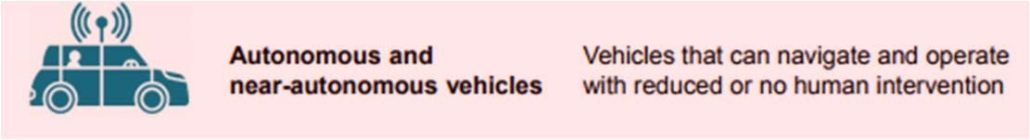
Do Embedded Systems have future?
Embedded Systems are an essential component
…
Manyika, James, et al. Disruptive technologies: Advances that will transform life, business, and the global economy. Vol. 180.
San Francisco, CA: McKinsey Global Institute, 2013.

Slide 7

Let’s dig in!

Slide 8
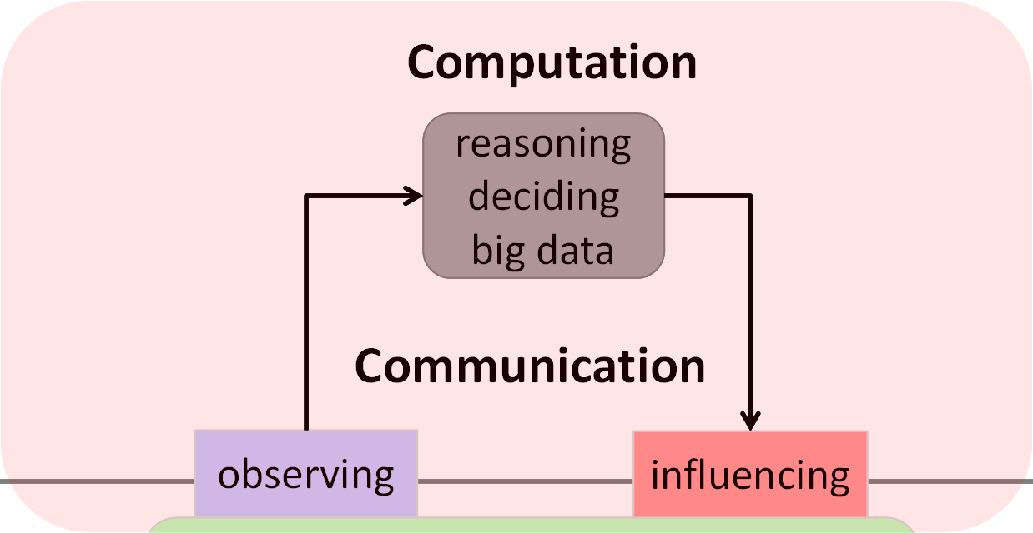
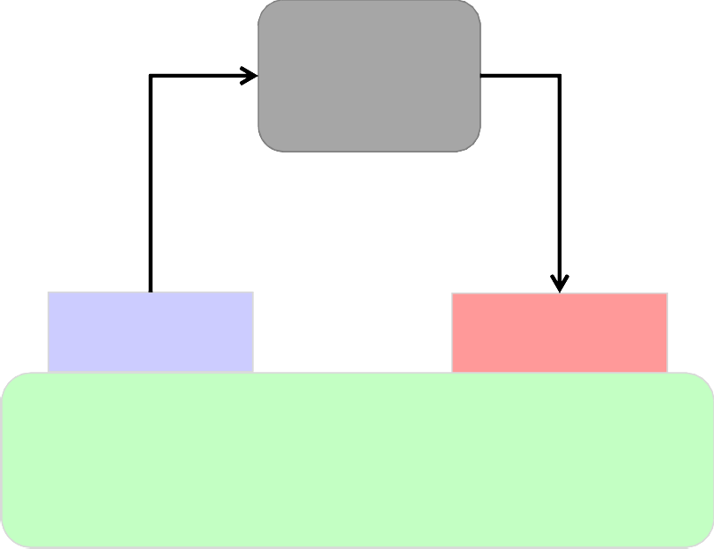
Embedded Systems: A pictorial view
Embedded System
Hardware &
Software
Computation
reasoning deciding big data
Communication
observing influencing
CYBER WORLD
PHYSICAL WORLD
physical/biological/social processes
Nature
Use feedback to influence the dynamics of the physical world by taking smart decisions in the cyber world

Slide 9
Embedded Systems: Design objectives
Predictability
Dependability
Efficiency
Energy and run-time efficient
Weight and cost efficient
“It is essential to predict how a CPS (cyber‐physical system) is going to behave under any circumstances […] before it is deployed.”^{Maj14}
“CPS must operate dependably, safely, securely, efficiently and in real‐time.”^{Raj10}
^{Maj14} R. Majumdar & B. Brandenburg (2014). Foundations of Cyber‐Physical Systems.
^{Raj10} R. Rajkumar et al. (2010). Cyber‐Physical Systems: The Next Computing Revolution.

Slide 10
Embedded Systems: Properties
Reactive: Must react to stimuli from environment
Time constrained: must meet real-time constraints
For hard real-time systems, right answers arriving too late are wrong.
Specialized: specialized towards few applications or domains
Domain knowledge helps optimize the design e.g. minimize resource usage, maximize predictability, etc.
“A reactive system is one which is in continual interaction with is environment and executes at a pace determined by that environment” [Bergé, 1995]
“A real‐time constraint is called hard, if not meeting that constraint could result in a catastrophe” [Kopetz, 1997].

Slide 11
Embedded vs General Purpose Systems
Embedded Systems
General Purpose Systems
Few applications (known at design time)
Not programmable by end user.
Fixed performance requirements (additional performance not useful)
Design criteria
Cost
Power consumption
Worst case speed
Size and weight
Dependability
Broad range of applications
Programmable by end user.
Higher performance is useful (enables new applications)
Design criteria
Cost
Power consumption
Average speed

Slide 12
Embedded System design flow
Requirements
Specification
Top-down design
Architecture
Bottom-up design
Components
Integration

Slide 13
Designing Embedded Systems
Requirements
Specification
Architecture
Components
Integration
Informal description of the system in layman’s language.
Functional: Answers the question-“What should the system do?”
E.g.: A GPS Moving Map should display the map of terrain around user’s current position.
Non-functional: Requirements not related to the functionality such as cost, size, power, etc.
E.g.: GPS Moving Map should cost under NOK 1000, fit on the palm, and run for atleast 8 hours on two batteries.

Slide 14
Designing Embedded Systems
Specification
Requirements
Architecture
Components
Integration
An unambiguous technical description derived from Requirements. Detailed enough to design the system architecture.
Examples:
Fit on palm: 2” x 4”
8 hours on batteries: 100mW

Slide 15
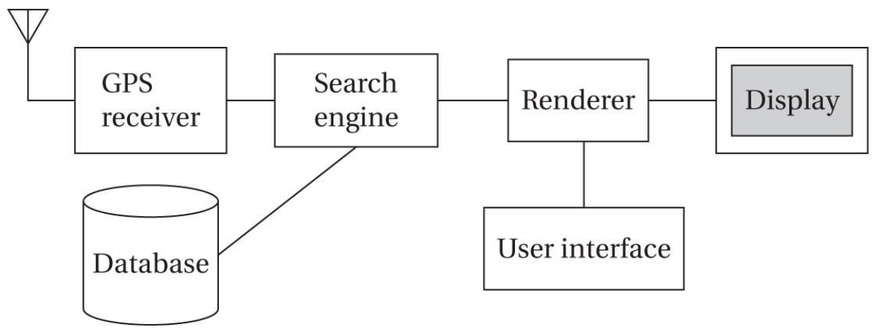
Designing Embedded Systems
Architecture
Requirements
Specification
Components
Integration
A high level overview of system structure in term of components needed and their interaction.
Key Challenge: How to distribute the functionality among hardware and software to meet the competing requirements: cost, performance, power..

Slide 16
Designing Embedded Systems
Components
Requirements
Specification
Architecture
Integration
Choose or build the component to implement the Architecture and meet the Specifications.
Standard components: CPUs, memory, software libraries, …
GPS receiver and topographic database are standard components
Custom components: Printed circuit boards, software modules, …
User interface is a component that might need custom design

Slide 17
Designing Embedded Systems
Integration
Requirements
Specification
Architecture
Components
Put the components together and make the system work!
Key Challenge: Unforeseen bugs popup during integration.
Requires debugging
Careful component designing can help a lot.

Slide 18
Embedded System: Hardware (H/W)
CPU
I/O devices
BUS
Memory

Slide 19
Embedded System: Programming the H/W
Compiler, Assembler, Optimizer
C - Code
Assembly Code
Operating System
CPU
I/O devices
BUS
Memory
H/W

Slide 20
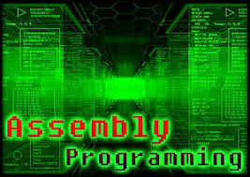
Let’s do something fun!

Slide 21
Assembly Programming
Why learn it?
Fun to talk to a processor in its native language
Most efficient way to program a processor (if you can get the code right!)
We will examine ARM ISA to learn assembly
ARM: Most popular mobile and embedded ISA.
ISA: Instruction Set Architecture

Slide 22
Instruction Set Architecture (ISA)
Programmer’s view of hardware
Interface between hardware and software
Defines processor recognizable machine instructions
Defines architecture state, memory management,…
Why is it useful?
Abstracts away hardware implementation details
Software can be developed (somewhat) independent of hardware implementation
Enables multiple implementations (called Microarchitectures) of the same ISA

Slide 23
Machine and assembly instructions
Machine instructions
Strings of binary numbers
Example: 01001011010100101011010010001010
Processor works with machine instructions but they are difficult for humans to understand
Assembly instructions
Symbolic representation of machine instructions
Easier for humans to understand
Strict one-to-one mapping between machine and assembly instructions

Slide 24
Assembly code example
High level language (c/Java) code: a[0]=b[0]+5;
Assembly code:
ldr r3,[r1] ; get the value to b[0] from memory to r3
add r4,r3,5 ; add 5 to b[0] and store in r4
str r4,[r2] ; save r4 to a[0]
mnemonic: what operation to perform
Comments. For code readability. Start with ;
Where to store the result of the operation
Where is the data required to perform the operation

Slide 25
Assembly code example
Hight level language (c/Java) code: a[0]=b[0]+5;
Assembly code:
ldr r3,[r1] ; get the value to b[0] from memory to r3
add r4,r3,5 ; add 5 to b[0] and store in r4
str r4,[r2] ; save r4 to a[0]
Things to notice:
Data needs to be brought to registers from memory to operate on it
Separate instructions to access data (from memory) and operate on it
Called load-store architecture
An alternative architecture: register memory architecture

Slide 26
Food for thought!
ldr r3,[r1] ; get the value to b[0] from memory to r3
add r4,r3,5 ; add 5 to b[0] and store in r4
str r4,[r2] ; save r4 to a[0]
How many and what instructions are available?
How long is an instruction?
Is there a limit on number of registers?
Does the address need to be in a register to access a memory location?
All of these are architecture (ISA) specific.

Slide 27
ARM architecture (ISA)
ARM is a load-store architecture
Offers several variants
ARMv8: 64-bit architecture
ARMv7: 32-bit architecture
All instructions are also 32-bit
Thumb architecture
16-bit instructions to reduce code size
Thumb-2 architecture
Supports both 16-bit and 32-bit instructions
You will use Thumb-2 in the labs.

Slide 28
Registers
Registers are storage locations inside the processor that hold program variables and control state
Thumb-2 provides 16 general-purpose registers (r0-r15) and a current program status register (CPSR). Each register is 32-bit wide
31
0
31
0
r0
r1
r2
r3
r4
r5
r6
r7
r8
r9
r10
r11
r12
r13 (SP)
r14 (LR)
r15 (PC)
31
0
CPSR
31
28
Negative | Zero | Carry | Overflow
SP: Stack Pointer
LR: Link Register
PC: Program Counter

Slide 29
Thumb-2 Instruction Categories
Memory access instructions
To transfer data between registers and memory
Only instructions that can access memory
Examples: ldr, str, etc.
Arithmetic/logic instructions
Perform the desired operation like: add, subtract, shift, or, and
Operate only on registers
Control transfer (a.k.a. branch) instructions
Control the flow of program execution
Jumps, loops, etc.
More details in the text book and Thumb-2 manuals!

Slide 30
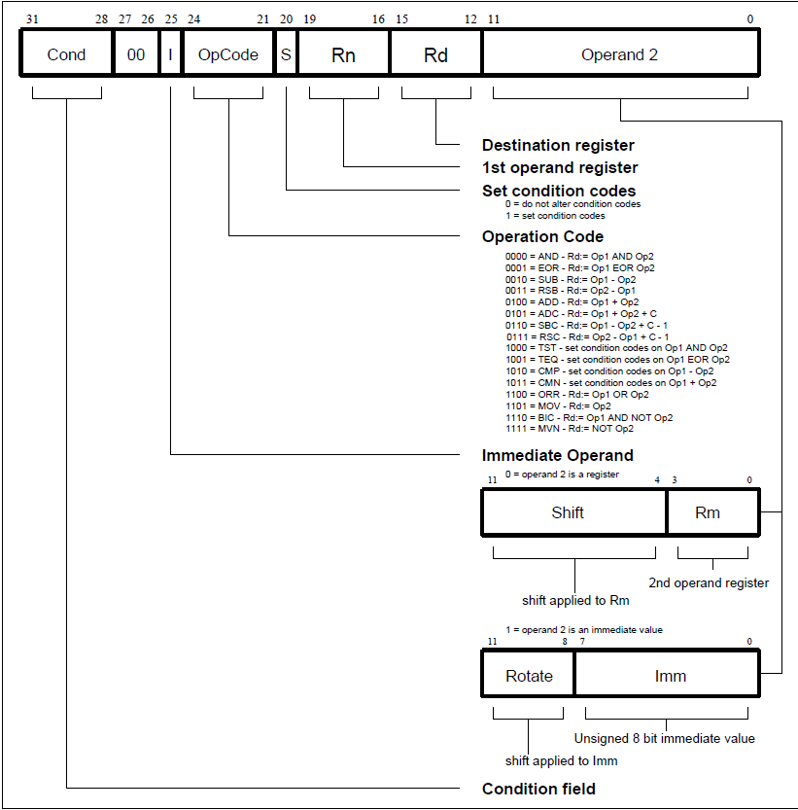
ARM Instruction Format
Not available for most of the Thumb2 instructions

Slide 31
Preparing to write an assembly program
Getting data from memory
High level language statement:
Memory
32 bits
0
4
8
A[0]
A[1]
A[…]
g = A[1] + 5
where
A[0] is the first element of array A and is pointed to by r2
r2
offset in bytes
Assembly code:
ldr r3, [r2, #4]
add r4, r3, 5
Memory is byte addressable
2³² - 4

Slide 32
Writing an assembly program
High Level Language Code
Assembly Code
.section .text
ldr r1, =a
ldr r2, [r1]
ldr r3, [r1, #4]
add r4, r2, r3
ldr r1, =x
str r4, [r1]
.section .data
a:
.word 10 ; a[0]
.word 20 ; a[1]
x:
.word 0 ; x
int a[2] = {10, 20};
int x;
x = a[0] + a[1];
ldr is a pseudo-op here.

Slide 33
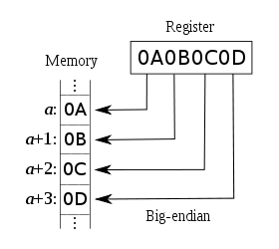
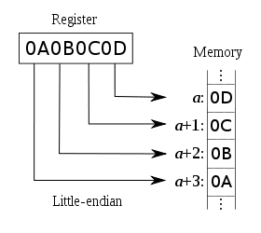
Memory addressing: Endianness
Given a memory address, Endianness tells where to find the first byte of a word.
ARM supports both little and big endianness

